Slide 1
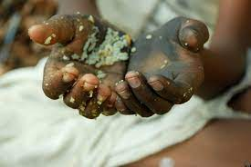
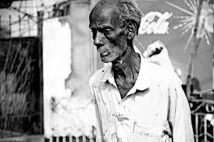
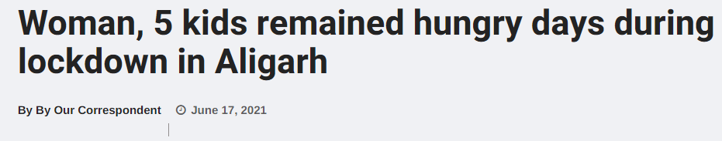

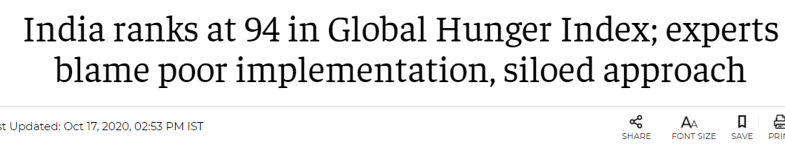
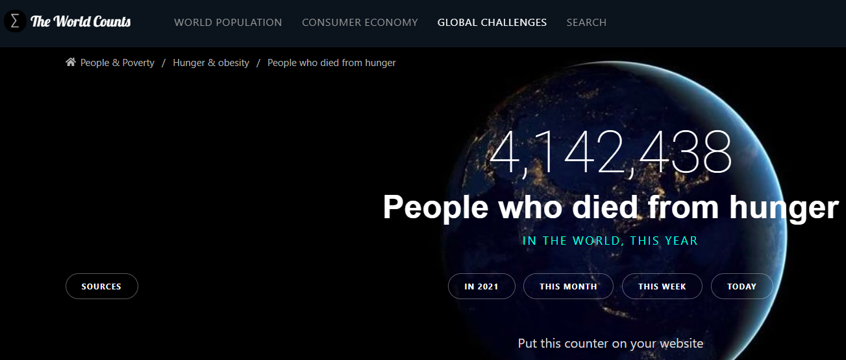
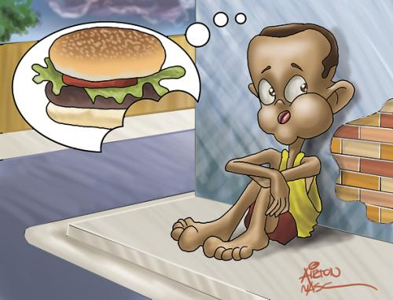

Hunger
The Biggest Fear
About 15 percent of India is undernourished
Source:Theborgenproject
FEEDING SPOON

Slide 2
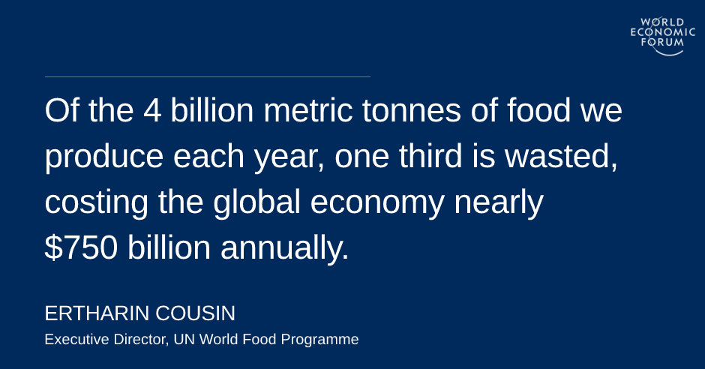
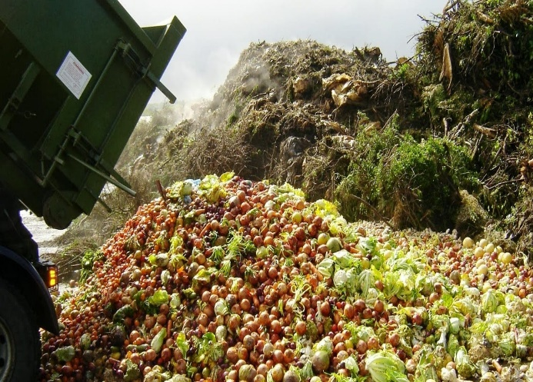
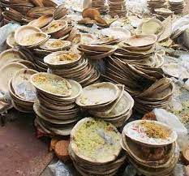

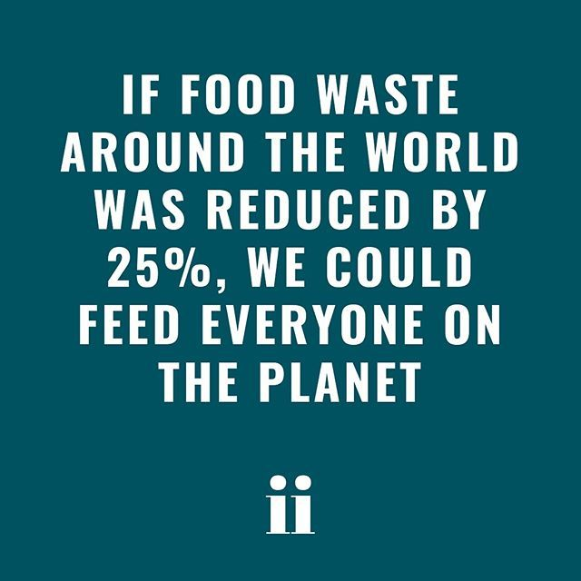
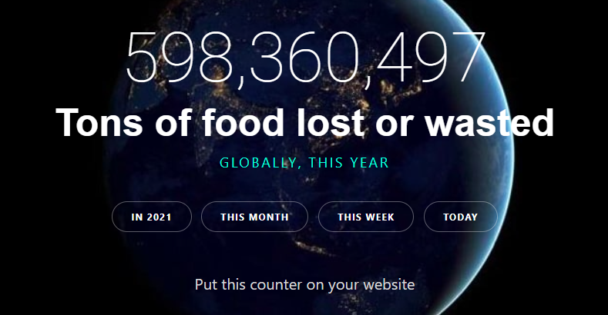
FEEDING SPOON
Food Wastage
The Biggest Crime

Slide 3








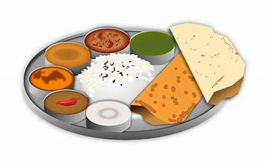











FEEDING SPOON
F
O
O
D
D
E
L
I
V
E
R
E
D
Are You Hungry
Healing earth
V
O
L
U
N
T
E
E
R
S
D
O
N
O
R
S
Need more help
Talk to FEEDO
Click on Feeding Spoon
Want To Volunteer
Donate Food
Click on Feeding Spoon
No Food Wastage
H
U
N
G
E
R
A
L
E
R
T
F
O
O
D
D
E
L
I
V
E
R
E
D
Click on Feeding Spoon
Click On Feeding Spoon
Donations: Cash / Sponsor a Thali
Left over Food From Parties/Gatherings/Canteens
D
O
N
O
R
S

Slide 4








Technologies Stack
FEEDING SPOON

Slide 5

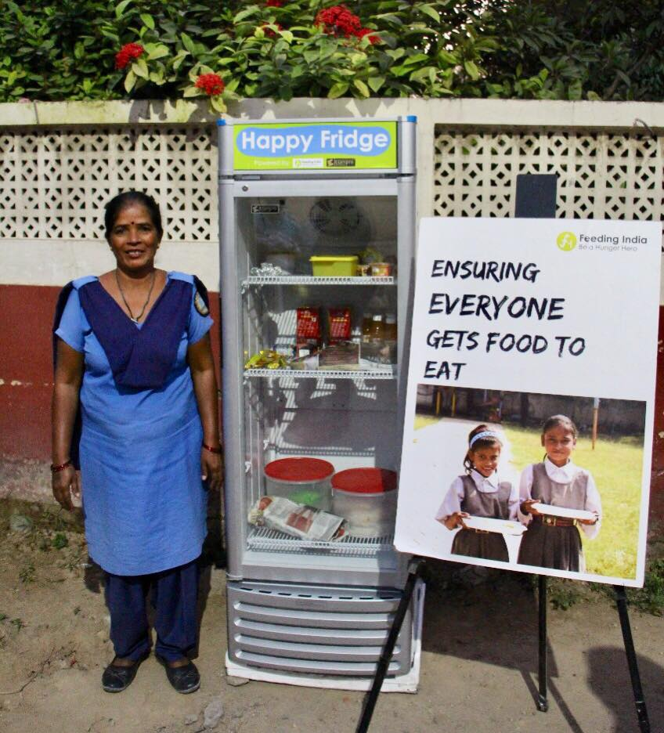
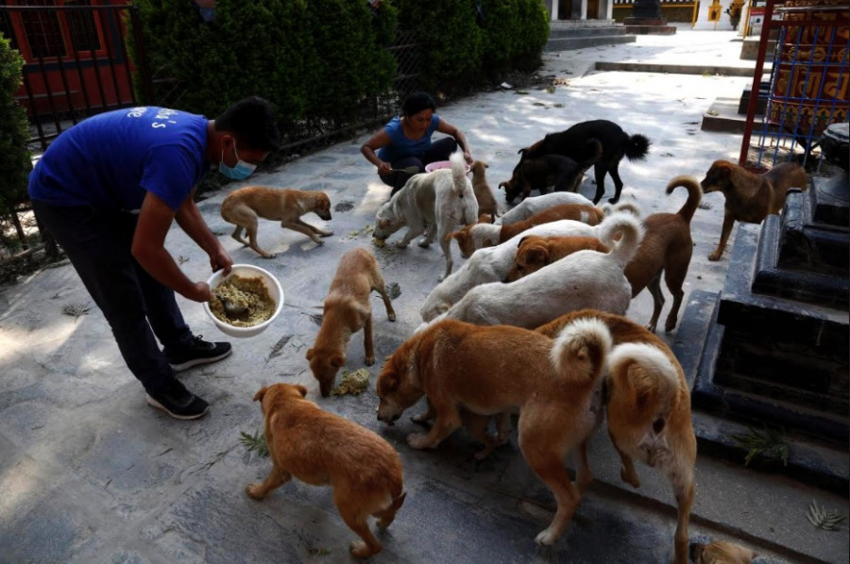

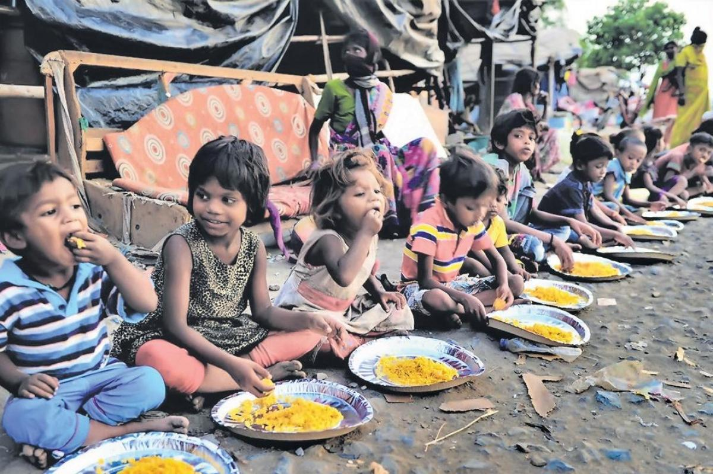
Our Goals
Promote Feeding Spoon to Targeted Source and Consumers to bridge the gap between Food Wastage and Hunger.
Spread Awareness on Government Policies on Food Wastage and Management
More Cities
Launch Pune
Add City
Add City
Add City
Add City
New Features
Add City
Launch Happy Refrigerator Locator
Organizing Event
Launch Food Sharing for Animals
Launch Food Recycling
June 2021
July 2021
Aug 2021
Sep 2021
Oct 2021
Nov 2021
Dec 2021
Jan 2022
Feb 2022
Mar 2022
Apr 2022
May 2022

